Slide 1
Choices after year 11
What are your options?

Slide 2
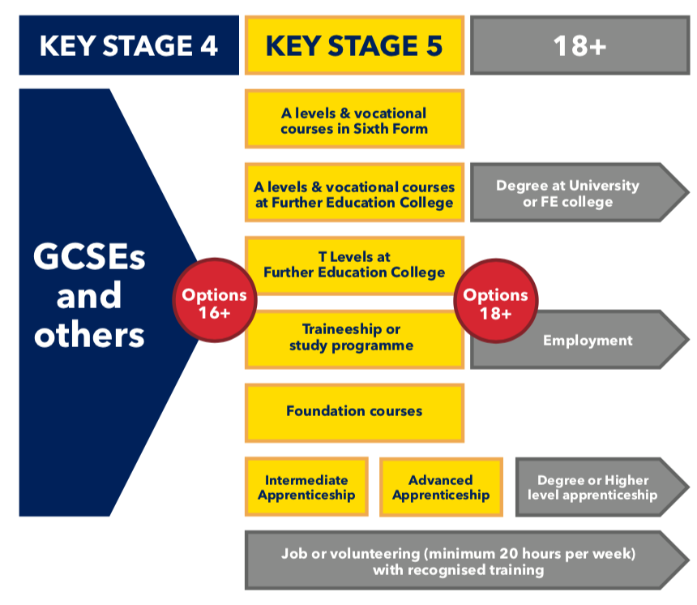
Progression Routes
All young people in England must continue in education or training until 18 years of age

Slide 3
What are your options after year 11?
College
Apprenticeships
Traineeships
Sixth Form
Volunteering combined with part time education
Internship (SEN)

Slide 4
LOCAL COLLEGES
Reading College
Bracknell and Wokingham College

Slide 5
APPRENTICESHIP

Slide 6
TRAINEESHIP

Slide 7
Entry requirements for Sixth Form
Entry requirements for sixth form depend on which A-Levels or BTECs you plan on taking.
Overall, it's advised that you have at least a grade 4-5 in all your GCSEs and a grade 6-7 in the subjects that you're planning on studying

Slide 8
VOLUNTEERTING
Volunteering enables people to play an active role in their society and contribute to positive social change. Volunteering helps to break down social barriers and offer people an opportunity to socialise with people from different social and cultural backgrounds.

Slide 9
SUPPORTED INTERNSHIPS (SEN)
Supported internships are for young people aged 16 — 24 with learning difficulties or learning disabilities, who want to get a job and need extra support to do this. To be eligible you need a Statement of Special Educational Needs and Disabilities (SEND), a Learning Difficulty Assessment, or an Education Health and Care Plan.

